Slide 1
Sycamore Growth Group
Advisory Firm: R&D Tax Credits
Founded: 2011
20 Employees
Point of Differentiation to Other Specialty R&D Firms
Industrial Strength Substantiation
Writing = Safety
Never had a certification rejected under audit
Rick Kleban rkleban@sycamoregrowthgroup.com 614-975-1280
Jamie Bean jbean@sycamoregrowthgroup.com

Slide 2
Topics
174 Rule Change
Relay what some other CPA’s are advising their client
Share our current understanding of application
Section 41 and Section 174 Interplay
Does claiming the R&D credit under section 41 impact treatment under 174?

Slide 3
What is Accounting Industry’s Position on 174?
Assumption: 174 Controls the Treatment for ALL expenses that meet the broad definition of Research & Experimentation (R&E)
Why Do They Think That?
174 applies to R&E expenditures “in connection with” the business
162 applies expenses to “carrying on” the business
Key Error: Industry wrongly thinks that 174 is a broader standard and thus must control ALL R&E cost treatment. Actually, 174 is the Lesser Standard.
*Dogs vs Wolves*

Slide 4
Why is the Industry So Entrenched?
Bias toward their own self interests.
Overpayment is “safe”
Safety in numbers.
Afraid to act differently.
If everyone is wrong, disgruntled clients have nowhere to run
Honest Confusion
Lesser known section of Tax Code
“Maybe we were always doing it wrong”
“It was six one way, a half dozen the other”

Slide 5
174 Election: Who Has to Use 174?
Start Ups (Pre Revenue)
Internal (self-funded) R&D that is for pursuing a business, NOT carrying on a business.
*Understand the nature of your activities and the stage of business to which they relate!

Slide 6
How do we support or interpretation?
Understand Congressional Intent (Matching)
Unlike ordinary and necessary expenses incurred in carrying on a trade or business, R&E investment provides unknown benefit over unknown amounts of time. Amortization better matches economic cost to benefit for investments, but not ordinary and necessary expenses.
Code Sections Must Work Together

Slide 7
R&E and the rest of the tax code
Is it reasonable to pull expenses out of COGS (471)?
There is precedent for the IRS treating COGS and deductions differently
Can we be certain that 174 over rules all other sections?
167: Fixed Assets
Clear guidance exists
162: Ordinary Business Expenses
Reasonable basis exists

Slide 8
Research & Experimentation (R&E) Expense Decision Tree
R&E Expense
Yes
No
Carrying on?
Carrying on?
Yes
No
Yes
No
COGS or FA?
Amortize 5 Yrs
(Start-Up)
COGS or FA?
Start-Up Expense
Yes
No
Yes
No
No
Yes
See 471 or 167
Ordinary & Necessary?
See 471 or 167
162
See 195
Basis
Yes
No
162
Amortize 5 Yrs

Slide 9
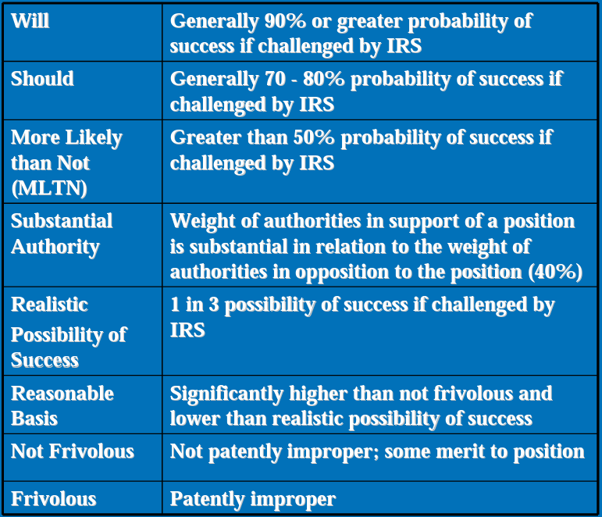
IRS Statements on Standards for Tax Services (AICPA)
How do I mitigate the chance of penalties?
Position must have “reasonable basis”
Industry Myth
Position should meet the standard of “more likely than not”

Slide 10
What about the Section 41 Credit?
Must I record expenses under section 174 to claim the Section 41 Credit?
No. Section 41 includes the “may clause”: Qualified research means research with respect to which expenditures may be treated as specified research or experimental expenditures under section 174…
The IRS Audit Techniques Guide for 41 calls this “The Section 174 Test”
If I don’t claim the Section 41 credit does that mean I can ignore section 174 amortization?
No. Foregoing the credit is not a shield against amortization under 174.
*Understand the nature of activity and stage of business!
Is the credit still beneficial?
Yes. The credit is still an important tool, regardless of how you record R&E

