Slide 1
National SBIR Spring Conference
Anaheim, CA
May 16, 2018
Jere Glover
Executive Director
Small Business Technology Council

Slide 2
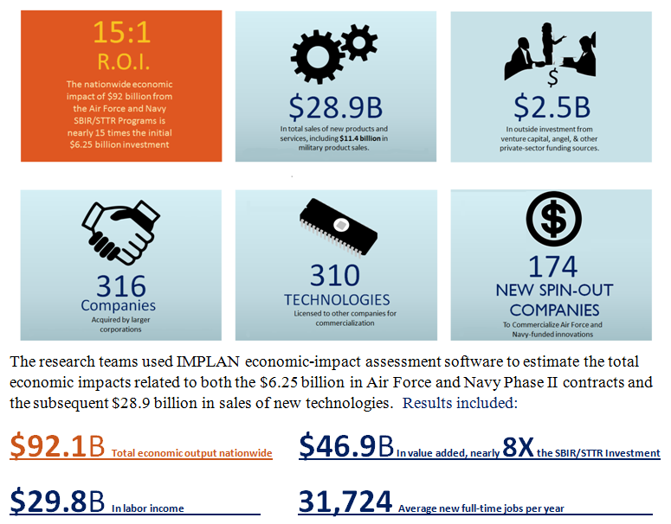
SBIR generates $14.7 in economic returns for every $1 invested
Source: National Economic Impacts from the Air Force and Navy SBIR/STTR
Programs, 2000-2013, Techlink.

Slide 3
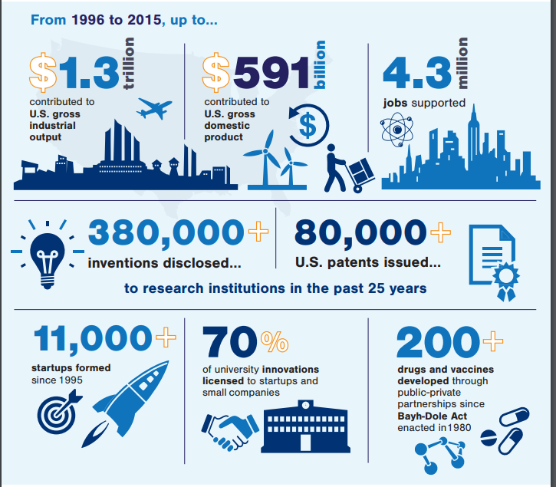
70% of University Licensing deals to Small Businesses
Source: AUTM FY2016 Licensing Survey

Slide 4
809 Panel Recommends Doubling SBIR
Section 809 Panel was tasked with finding ways to streamline and improve DOD acquisition
Their recommendations included making SBIR permanent and increasing allocation to 7.0%

Slide 5
SBIR Firms Produce >20% of Key Innovations

Slide 6
Bloomberg 2018 Innovation Index
Bloomberg 2018 Innovation Index

Slide 7
Number of SBIR/STTR Awards vs VC Seed Deals

Slide 8
M&A Deals in Decline since 2015

Slide 9
VC Seed deals Concentrated by Industry and State

Slide 10
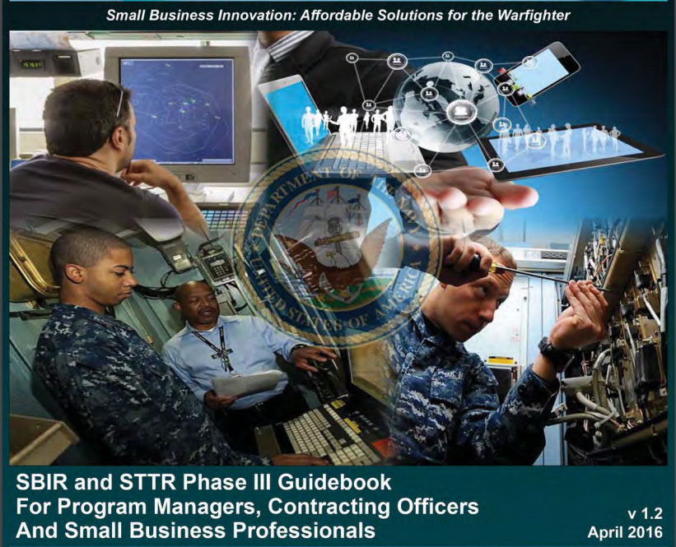
Navy Phase III Guidebook

Slide 11
SBIR Data Rights

Slide 12
SBIR Data Rights vs Patent Protection

