Slide 1
SBIR Economic Impact & Legislation Beyond Phase II August 17, 2017 Chicago, IL
Jere Glover
Executive Director
Small Business Technology Council

Slide 3
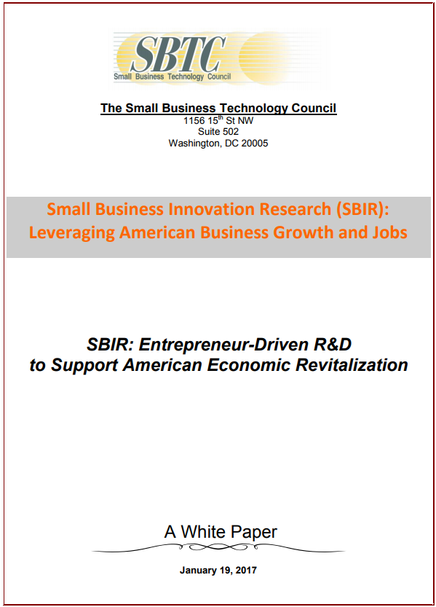

Slide 4
SBIR Successes
1.7% of total Federal R&D Funding
25% of Key Innovations
1 SBIR Technology Saved $500 million on F-35 program
Qualcomm, Symantec, Biogen, iRobot, Genzyme, Illumina, Gentech all received SBIR awards
45%-70% of SBIR Phase II technologies have been commercialized
Federal Government receives $4.16 in Federal taxes for every dollar spent on SBIR
217% Return on Taxes at the state and local level

Slide 5
SBIR Legislative History
Reagan & Congress created SBIR in 1982
SBIR then reauthorized for 6 years to 1988, 7 years to 1993, 8 years to 2000, 8 years to 2008
14 Continuing Resolutions before 2011 6 year Reauthorization passed
Reauthorized in the 2017 NDAA for another five years until 2022

Slide 6
SBIR Creates 25% of Key Innovations

Slide 7
Small Business % of Federal R&D
96.86% of Federal R&D goes to Big Business, Universities, and Labs (in 2012). Only about 3% of the funding goes to small business

Slide 8
Chairman Lamar Smith on SBIR
“SBIR began with a deduction of 0.2 percent from agencies’ research budgets. Today, the SBIR allocation from basic research is 3.2 percent, or 16 times higher. Eleven federal agencies with research budgets of $100 million or more are currently subject to the SBIR funding ‘tax’.”
“This is a significant diversion at a time when U.S. research and development leadership is under challenge.”
“…we must assure that not a single tax dollar is wasted.” – Waste, Fraud, & Abuse
-Statement of Chairman Lamar Smith before the Committee on Science, Space, & Technology, May 4, 2017

Slide 9
Pending Legislation
2018 NDAA
Sec. 897 Phase III Awards:
“SBIR Awards considered to satisfy competition requirements, and issue, without further justification, Phase III Awards”
Sec. 898 (d) Use Of Contract Vehicle:
“A multiple award contract described in subsection (b) may be used by any service or component of the Department.”
HR 2763 SBIR/STTR Improvement Bill, Sec. 9:
“as direct follow-on awards issued without further competition”

Slide 10
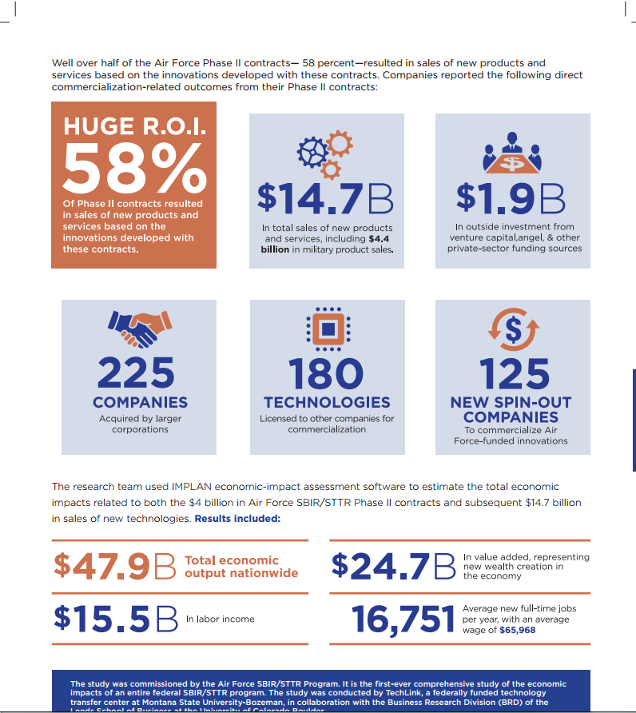
Air Force SBIR Ecomonic Impacts

Slide 11
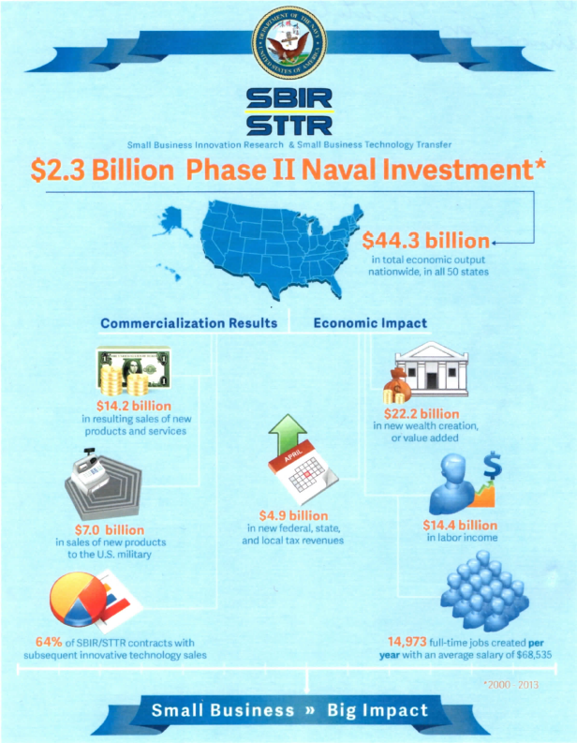
Navy SBIR Economic Impacts

Slide 12
DOD SBIR Economic Impact Study
The DOD has commissioned a DOD-wide study of the economic impacts of the SBIR/STTR Programs that is currently being undertaken.

Slide 13
Navy SBIR Phase III Guidebook

Slide 14
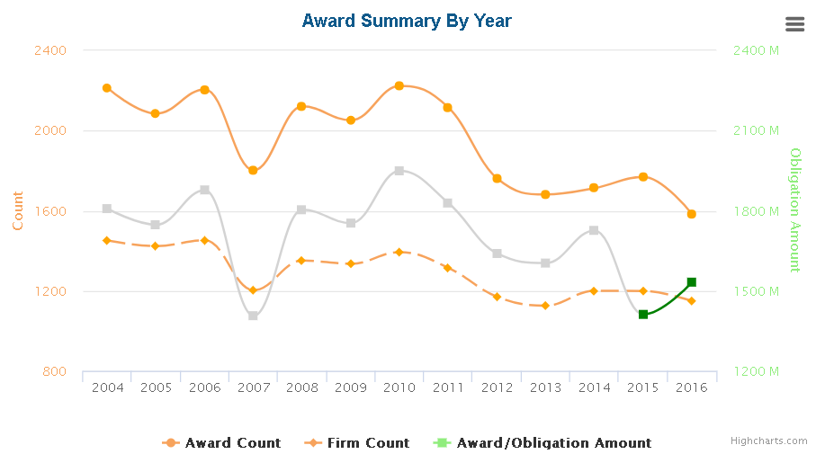
DoD SBIR/STTR Awards, PH I
Source: https://www.sbir.gov/analytics-dashboard?phase_tid%5B%5D=105789&year%5B%5D=2016&year%5B%5D=2015&year%5B%5D=2014&year%5B%5D=2013&year%5B%5D=2012&year%5B%5D=2011&year%5B%5D=2010

